Slide 1
Machine learning 101 Linear regression and Bayes method
Han Xiao
hxiao29@wisc.edu
CEE department

Slide 2
Objective
Two supervised methods: linear regression+Bayes method
Be able to write code in linear regression
Apply Bayes method in classification problems

Slide 3
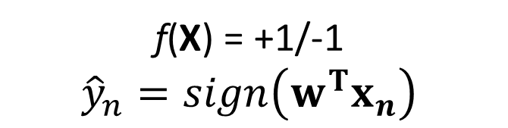

PLA
Training PLA:
Step1: initiate a random w₀
Step2:
- Run ${\hat{y}}_{n}=sign\left(w^{T}x_{n}\right)$ for every training data
- Randomly choose one data which ${\hat{y}}_{n}≠y_{n}$
- Update the weight with $w_{t+1}←w_{t}+y_{n}x_{n}$
Step3: run the algorithm until no error exists
f(X) = +1/-1
$${\hat{y}}_{n}=sign\left(w^{T}x_{n}\right)$$

Slide 4
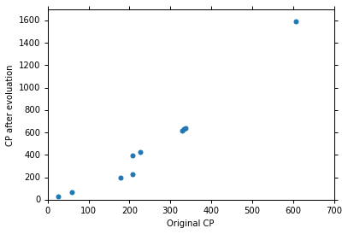


Linear regression
f(X)$∈R$
$${\hat{y}}_{n}=w^{T}x_{n}$$

Slide 5
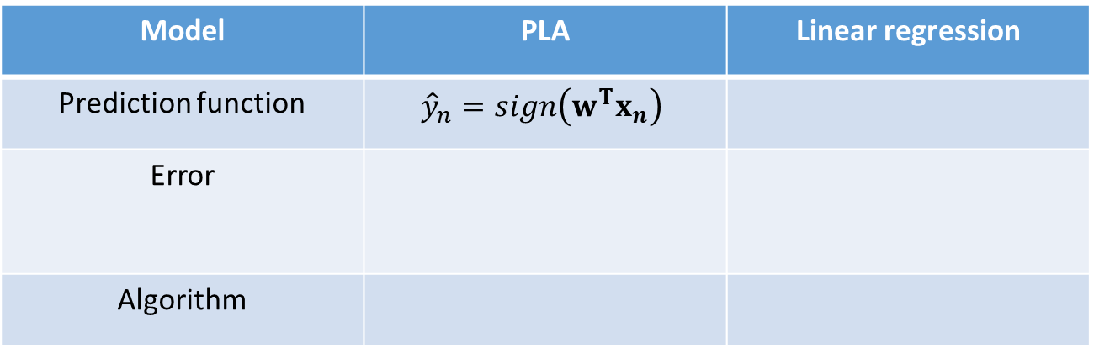




Linear regression
Model | PLA | Linear regression
Prediction function | $${\hat{y}}_{n}=sign\left(w^{T}x_{n}\right)$$
Error
Algorithm
$${\hat{y}}_{n}=w^{T}x_{n}$$
$$\sum_{i=1}^{n}{⟦{\hat{y}}_{i}≠y_{i}⟧}$$
$$\frac{1}{N}\sum_{i=1}^{N}{(}{y_{i}−{\hat{y}}_{i})}^{2}$$
$$w_{t+1}←w_{t}+y_{n}x_{n}$$
???

Slide 6
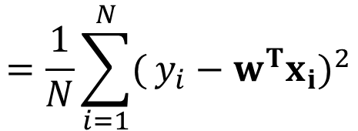

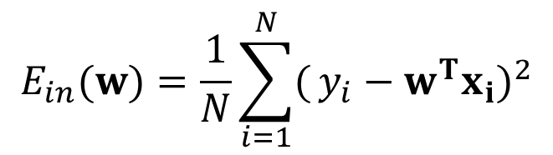
Linear regression
$$E_{in}=\frac{1}{N}\sum_{i=1}^{N}{(}{y_{i}−{\hat{y}}_{i})}^{2}$$
$$=\frac{1}{N}\sum_{i=1}^{N}{(}{y_{i}−w^{T}x_{i})}^{2}$$
$$E_{in}(w)=\frac{1}{N}\sum_{i=1}^{N}{(}{y_{i}−w^{T}x_{i})}^{2}$$
Convex equation (always have an optimal solution)

Slide 7
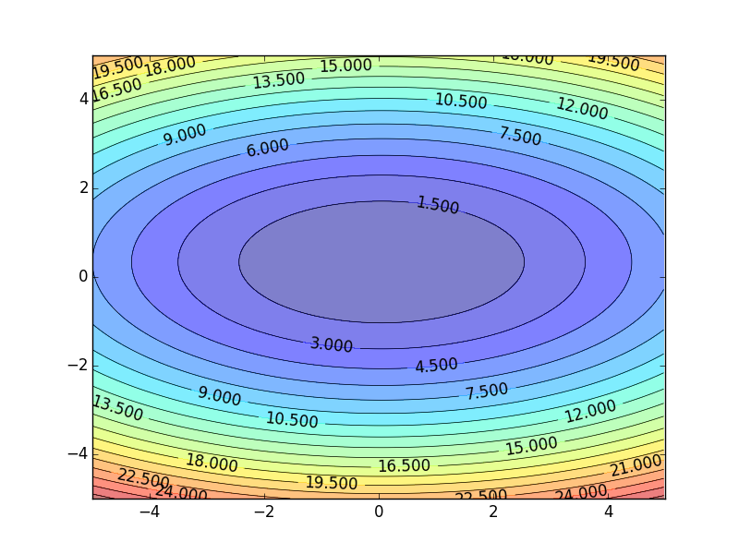
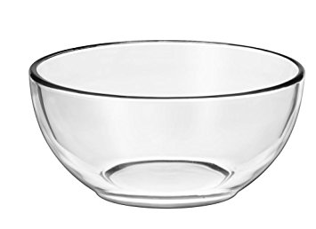


Linear regression
Convex problem-- always have an optimal solution
$$w$$
$$b$$

Slide 8
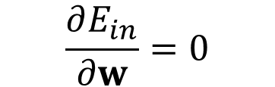
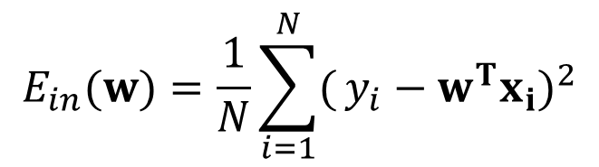
Linear regression
$$E_{in}(w)=\frac{1}{N}\sum_{i=1}^{N}{(}{y_{i}−w^{T}x_{i})}^{2}$$
How to solve it?
Goal: find a w to make E_{in} as small as possible
Gradient = 0
$$\frac{∂E_{in}}{∂w}=0$$

Slide 9
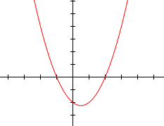
Linear regression
Gradient → tangent of slope of function
For quadratic function:

Slide 10
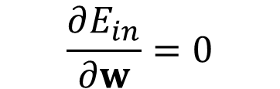
Linear regression
$$E_{in}(w)=\frac{1}{N}\sum_{i=1}^{N}{(}{y_{i}−w^{T}x_{i})}^{2}$$
$$\frac{∂E_{in}}{∂w}=0$$
Basic linear algebra operations!

Slide 11
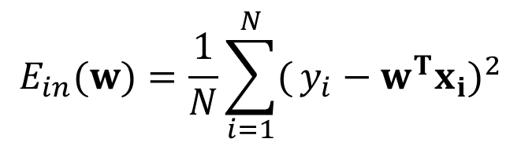
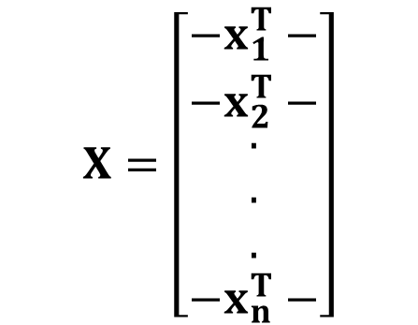
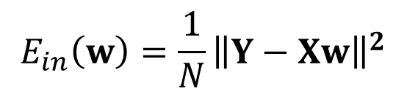
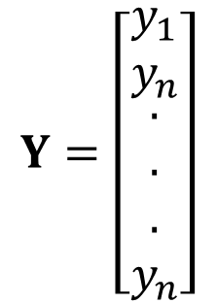
Linear regression
$$E_{in}(w)=\frac{1}{N}\sum_{i=1}^{N}{(}{y_{i}−w^{T}x_{i})}^{2}$$
$$X=\left[\begin{matrix}−x_{1}^{T}− \\ −x_{2}^{T}− \\ \begin{aligned}. \\ . \\ . \\ −x_{n}^{T}−\end{aligned}\end{matrix}\right]$$
$$Y=\left[\begin{matrix}y_{1} \\ y_{n} \\ \begin{aligned}. \\ . \\ . \\ y_{n}\end{aligned}\end{matrix}\right]$$
$$E_{in}\left(w\right)={\frac{1}{N}\left\|Y−Xw\right\|}^{2}$$

Slide 12
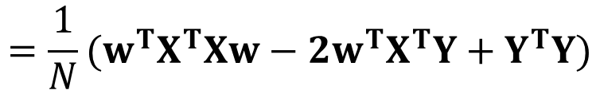
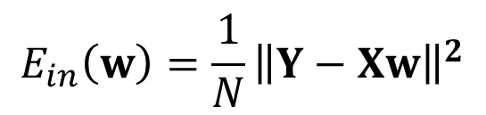

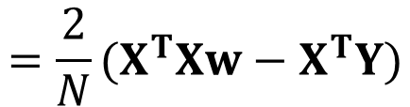
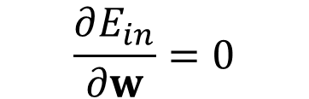
Linear regression
$$E_{in}\left(w\right)={\frac{1}{N}\left\|Y−Xw\right\|}^{2}$$
$$=\frac{1}{N}(w^{T}X^{T}Xw−2w^{T}X^{T}Y+Y^{T}Y)$$
$$\frac{∂E_{in}}{∂w}=0$$
$$=\frac{2}{N}{(X}^{T}Xw−X^{T}Y)$$
$$w={{(X}^{T}X)}^{−1}X^{T}Y$$
Pseudo-inverse of X

Slide 13

Linear regression
$w={{(X}^{T}X)}^{−1}X^{T}Y=X^{+}Y$
One step to the end!
If you don’t want to bother with linear algebra…
Sklearn:
regr = linear_model.LinearRegression()
regr.fit(X_train, y_train)
y_pred = regr.predict(X_test)
http://scikit-learn.org/stable/auto_examples/linear_model/plot_ols.html#sphx-glr-auto-examples-linear-model-plot-ols-py

Slide 14
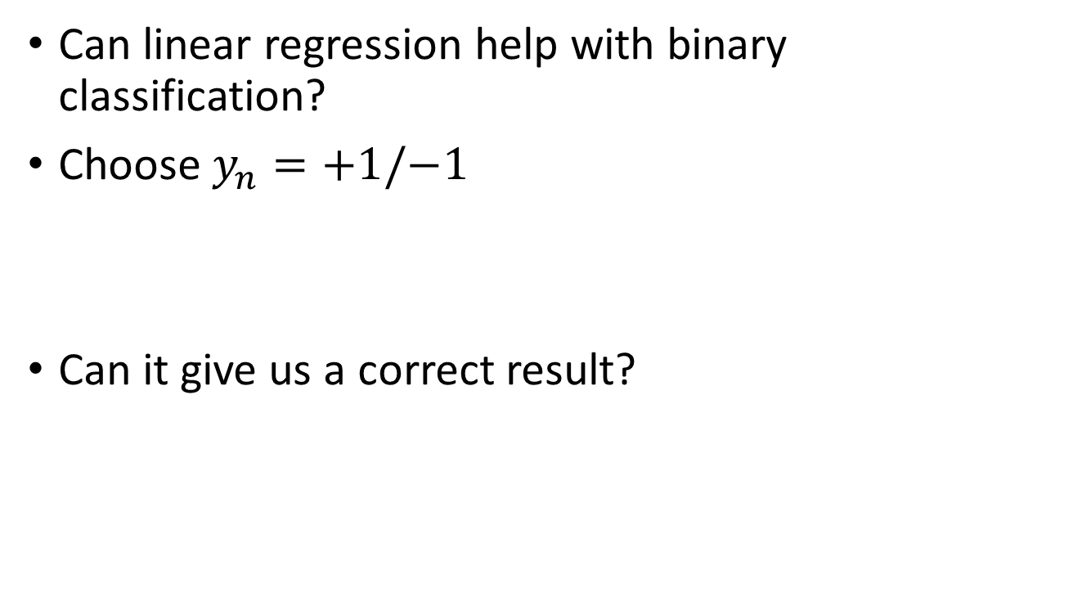
Linear regression and PLA
Can linear regression help with binary classification?
Choose $y_{n}=+1/−1$
Can it give us a correct result?

Slide 15
to decrease error
Class 2
Class 2
-1
-1
Multiple class: Class 1 means the target is 1; Class 2 means the target is 2; Class 3 means the target is 3 …… problematic
1
1
x₂
x₂
Class 1
Class 1
>>1
error
x₁
x₁
Penalize to the examples that are “too correct” …
(Bishop, P186)
Notes:
-0.142857142857 0.285714285714

Slide 16
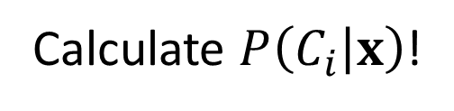
Bayes method
What if we don’t want a strict classification?
Cancer examination in hospital:
- Hard to really say whether you will get disease in the future based on your info!
- Use probability (soft classification)
Given input x, what’s the probability of it belonging to one class
- Bayesian method is still a strict classification using posterior probability
Calculate $P\left(C_{i} | x\right)$!

Slide 17
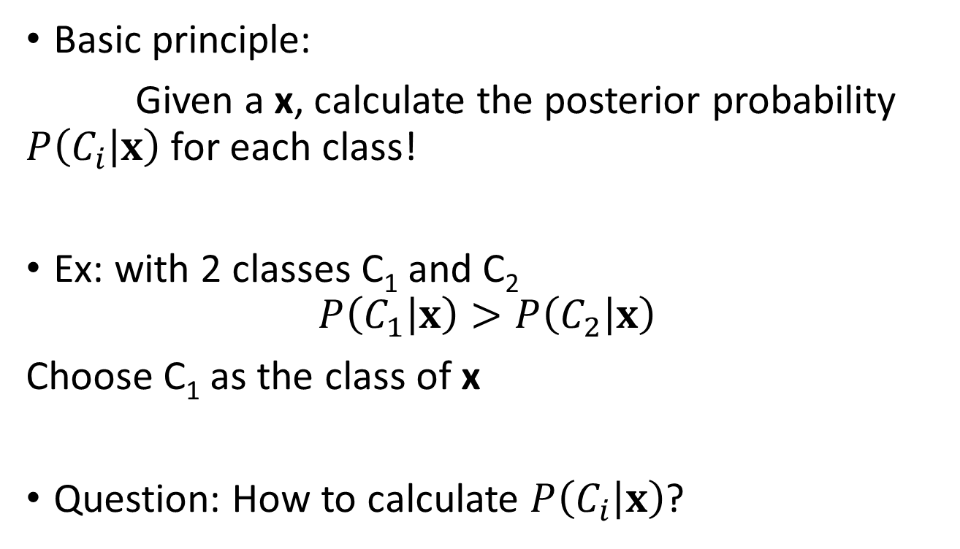
Bayes method
Basic principle:
Given a x, calculate the posterior probability $P\left(C_{i} | x\right)$ for each class!
Ex: with 2 classes C₁ and C₂
$$P\left(C_{1} | x\right)>P\left(C_{2} | x\right)$$
Choose C₁ as the class of x
Question: How to calculate $P\left(C_{i} | x\right)$?

Slide 18
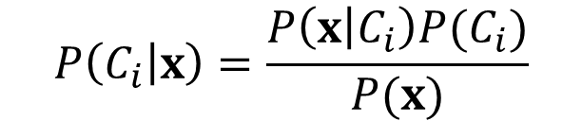
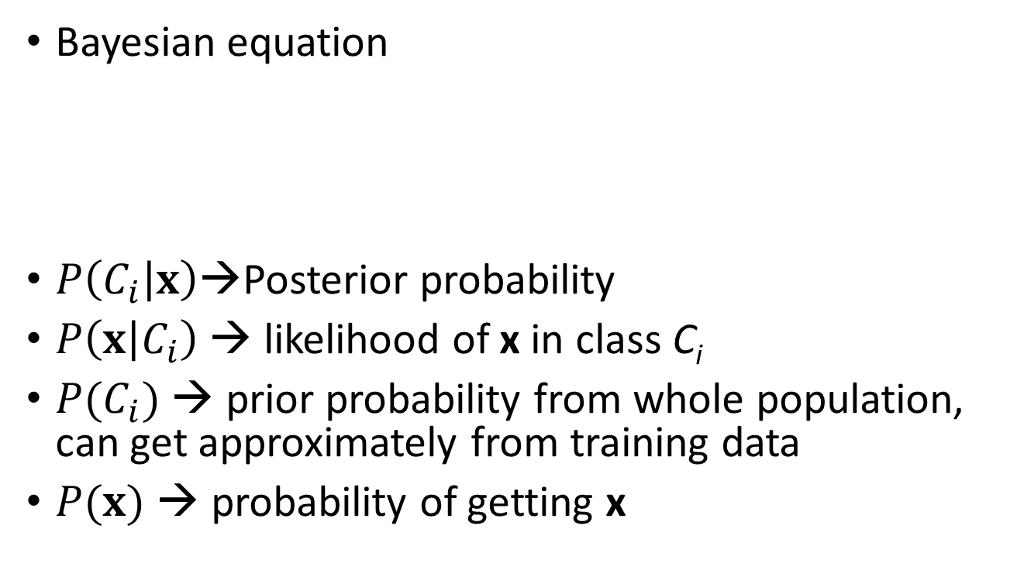
Bayes method
Bayesian equation
$P\left(C_{i} | x\right)$→Posterior probability
$P\left(x | C_{i}\right)$ → likelihood of x in class C_{i}
$P(C_{i})$ → prior probability from whole population, can get approximately from training data
$P(x)$ → probability of getting x
$$P\left(C_{i} | x\right)=\frac{P\left(x | C_{i}\right)P(C_{i})}{P(x)}$$

Slide 19

Bayes method
$$P(Yes)=4/8$$
x are discrete variables
Day | Outlook | Temperature | Humidity | Wind | Play Tennis?
1 | Sunny | Hot | High | Weak | No
2 | Sunny | Hot | High | Strong | No
3 | Overcast | Hot | High | Weak | Yes
4 | Rain | Mild | High | Weak | Yes
5 | Rain | Cool | Normal | Weak | Yes
6 | Rain | Cool | Normal | Strong | No
7 | Overcast | Cool | Normal | Strong | Yes
8 | Sunny | Mild | High | Weak | No
9 | Overcast | Mild | Normal | Strong | ???

Slide 20
Bayes method
Assume independent features
Day | Outlook | Temperature | Humidity | Wind | Play Tennis?
1 | Sunny | Hot | High | Weak | No
2 | Sunny | Hot | High | Strong | No
3 | Overcast | Hot | High | Weak | Yes
4 | Rain | Mild | High | Weak | Yes
5 | Rain | Cool | Normal | Weak | Yes
6 | Rain | Cool | Normal | Strong | No
7 | Overcast | Cool | Normal | Strong | Yes
8 | Sunny | Mild | High | Weak | No
9 | Overcast | Mild | Normal | Strong | ???
$$P\left(Yes | Overcast,Mild,Normal,Strong\right)=\frac{P\left(Overcast,Mild,Normal,Strong | Yes\right)P(Yes)}{P(Overcast,Mild,Normal,Strong)}$$

Slide 21
Bayes method
$$P\left(Yes | Overcast,Mild,Normal,Strong\right)=\frac{P\left(Overcast,Mild,Normal,Strong | Yes\right)P(Yes)}{P(Overcast,Mild,Normal,Strong)}$$
$$=\frac{P\left(Overcast | Yes\right)P\left(Mild | Yes\right)P\left(Normal | Yes\right)P\left(Strong | Yes\right)P(Yes)}{P\left(Overcast\right)P\left(Mild\right)P\left(Normal\right)P(Strong)}$$
Day | Outlook | Temperature | Humidity | Wind | Play Tennis?
1 | Sunny | Hot | High | Weak | No
2 | Sunny | Hot | High | Strong | No
3 | Overcast | Hot | High | Weak | Yes
4 | Rain | Mild | High | Weak | Yes
5 | Rain | Cool | Normal | Weak | Yes
6 | Rain | Cool | Normal | Strong | No
7 | Overcast | Cool | Normal | Strong | Yes
8 | Sunny | Mild | High | Weak | No
9 | Overcast | Mild | Normal | Strong | ???

Slide 22
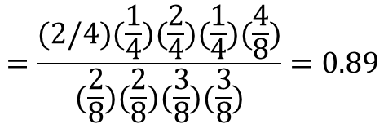
Bayes method
$$=\frac{P\left(Overcast | Yes\right)P\left(Mild | Yes\right)P\left(Normal | Yes\right)P\left(Strong | Yes\right)P(Yes)}{P\left(Overcast\right)P\left(Mild\right)P\left(Normal\right)P(Strong)}$$
$$=\frac{(2/4)(\frac{1}{4})(\frac{2}{4})(\frac{1}{4})(\frac{4}{8})}{(\frac{2}{8})(\frac{2}{8})(\frac{3}{8})(\frac{3}{8})}=0.89$$
Yes!
Day | Outlook | Temperature | Humidity | Wind | Play Tennis?
1 | Sunny | Hot | High | Weak | No
2 | Sunny | Hot | High | Strong | No
3 | Overcast | Hot | High | Weak | Yes
4 | Rain | Mild | High | Weak | Yes
5 | Rain | Cool | Normal | Weak | Yes
6 | Rain | Cool | Normal | Strong | No
7 | Overcast | Cool | Normal | Strong | Yes
8 | Sunny | Mild | High | Weak | No
9 | Overcast | Mild | Normal | Strong | ???

Slide 23
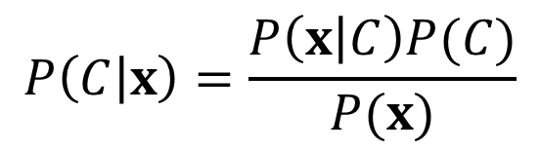

Bayes method
For $x∈R^{d}$
$$P\left(C | x\right)=\frac{P\left(x | C\right)P(C)}{P(x)}$$
P(C) is easy to get from training examples, prior probability
P(x) is not important, the same for different classes
P(x|C)???????????????????

Slide 24
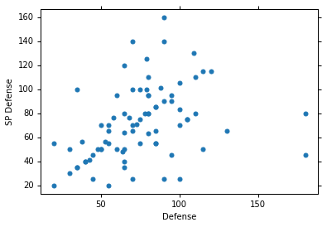
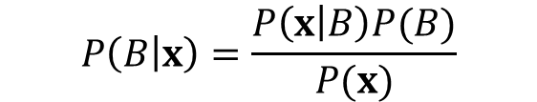
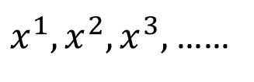



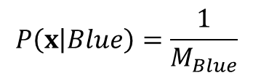
Bayes method
$$P\left(B | x\right)=\frac{P\left(x | B\right)P(B)}{P(x)}$$
$$P\left(B\right)=\frac{N_{B}}{N}$$
$$P\left(Y\right)=\frac{N_{Y}}{N}$$
$$P\left(x | Blue\right)=\frac{1}{M_{Blue}}$$
$x^{1},x^{2},x^{3},$ ……
New x
Assume the points are sampled from a Gaussian distribution.
$P\left(x | Blue\right)=0$?

Slide 25
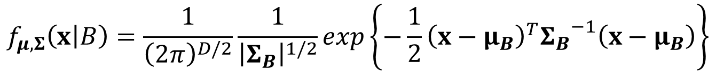

Bayes method
Assume Gaussian distribution
$$f_{μ,Σ}\left(x | B\right)=\frac{1}{{\left(2π\right)}^{D/2}}\frac{1}{{\left|Σ_{B}\right|}^{1/2}}exp\left\{−\frac{1}{2}{\left(x−μ_{B}\right)}^{T}{Σ_{B}}^{−1}\left(x−μ_{B}\right)\right\}$$
How to decide the mean $μ_{B}$ and covariance matrix$Σ_{B}$?

Slide 26

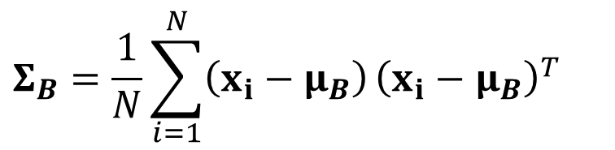

Bayes method
Maximum likelihood
Get the gradient
$$P\left(x_{1},x_{2}, …,x_{n} | B\right)=f_{μ,Σ}\left(x_{1} | B\right)f_{μ,Σ}\left(x_{2} | B\right)……f_{μ,Σ}\left(x_{n} | B\right)$$
$$\frac{∂P}{∂μ}=0 \frac{∂P}{∂Σ}=0$$
$$μ_{B}=\frac{1}{N}\sum_{i}^{N}{x_{i}}$$
$$Σ_{B}=\frac{1}{N}\sum_{i=1}^{N}{\left(x_{i}−μ_{B}\right)}{\left(x_{i}−μ_{B}\right)}^{T}$$

Slide 27
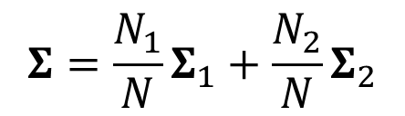

Bayes method
Bishop, chapter 4.2.2
Important assumption
Assume different classes share the same covariance
To decrease the number of variables, different classes share same $Σ$
$$Σ=\frac{N_{1}}{N}Σ_{1}+\frac{N_{2}}{N}Σ_{2}$$

Slide 28
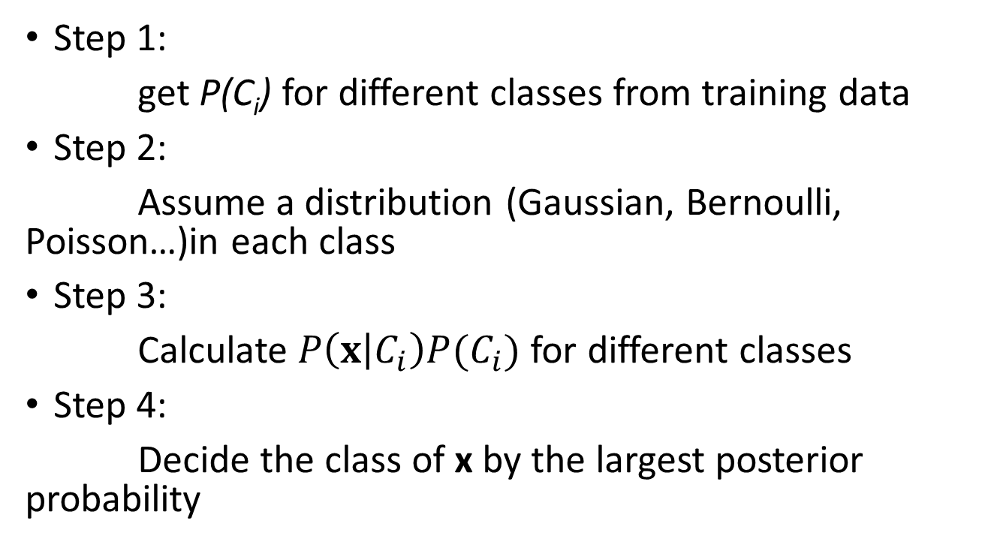
Bayes method
Step 1:
get P(C_{i}) for different classes from training data
Step 2:
Assume a distribution (Gaussian, Bernoulli, Poisson…)in each class
Step 3:
Calculate $P\left(x | C_{i}\right)P(C_{i})$for different classes
Step 4:
Decide the class of x by the largest posterior probability

Slide 29
Bayes method
$$=\frac{P\left(Overcast | Yes\right)P\left(Mild | Yes\right)P\left(Normal | Yes\right)P\left(Strong | Yes\right)P(Yes)}{P\left(Overcast\right)P\left(Mild\right)P\left(Normal\right)P(Strong)}$$
$$=\frac{(2/4)(\frac{1}{4})(\frac{2}{4})(\frac{1}{4})(\frac{4}{8})}{(\frac{2}{8})(\frac{2}{8})(\frac{3}{8})(\frac{3}{8})}=0.89$$
Yes!
Day | Outlook | Temperature | Humidity | Wind | Play Tennis?
1 | Sunny | Hot | High | Weak | No
2 | Sunny | Hot | High | Strong | No
3 | Overcast | Hot | High | Weak | Yes
4 | Rain | Mild | High | Weak | Yes
5 | Rain | Cool | Normal | Weak | Yes
6 | Rain | Cool | Normal | Strong | No
7 | Overcast | Cool | Normal | Strong | Yes
8 | Sunny | Mild | High | Weak | No
9 | Overcast | Mild | Normal | Strong | ???
Did you find something weird?
P(Sunny|yes) = 0!

Slide 30
Bayes method
9 | Sunny | Cool | Normal | Weak | Yes
10 | Rain | Mild | Normal | Weak | Yes
11 | Sunny | Mild | Normal | Strong | Yes
12 | Overcast | Mild | High | Strong | Yes
13 | Overcast | Hot | Normal | Weak | Yes
14 | Rain | Mild | High | Strong | No
The method will make some assumptions when data is not enough!

Slide 31
Bayes method
Advantage:
Sometimes you don’t need a whole data set
Easy to apply
Disadvantage:
The distribution assumed is correct?
Outputs might be wrong!

Slide 32
Bayes method
Application
Sentence generator:
You are a good boy!
Given ‘you’:
P(are|you)P(a|you are)P(good|you are a)…
May give you: you are a good girl!

Slide 33

Questions?
Topic of next lecture: Discriminative vs generative methods

Slide 34
Bayes method
MATH ALERT!

Slide 35
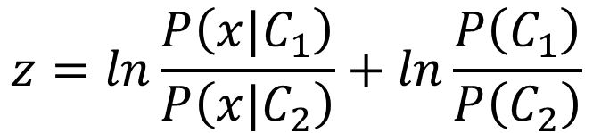

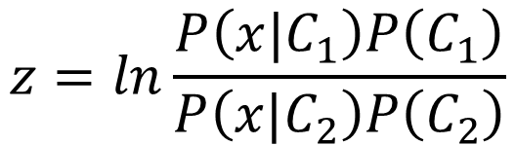
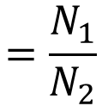

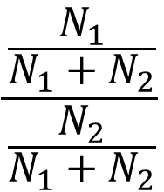
Posterior Probability
$$z=ln\frac{P\left(x|C_{1}\right)P\left(C_{1}\right)}{P\left(x|C_{2}\right)P\left(C_{2}\right)}$$
$$P\left(C_{1}|x\right)$$
$$=σ\left(z\right)$$
sigmoid
$$\frac{\frac{N_{1}}{N_{1}+N_{2}}}{\frac{N_{2}}{N_{1}+N_{2}}}$$
$$z=ln\frac{P\left(x|C_{1}\right)}{P\left(x|C_{2}\right)}+ln\frac{P\left(C_{1}\right)}{P\left(C_{2}\right)}$$
$$=\frac{N_{1}}{N_{2}}$$
$$P\left(x|C_{1}\right)=\frac{1}{{\left(2π\right)}^{D/2}}\frac{1}{{\left|Σ^{1}\right|}^{1/2}}exp\left\{−\frac{1}{2}{\left(x−μ^{1}\right)}^{T}{\left(Σ^{1}\right)}^{−1}\left(x−μ^{1}\right)\right\}$$
$$P\left(x|C_{2}\right)=\frac{1}{{\left(2π\right)}^{D/2}}\frac{1}{{\left|Σ^{2}\right|}^{1/2}}exp\left\{−\frac{1}{2}{\left(x−μ^{2}\right)}^{T}{\left(Σ^{2}\right)}^{−1}\left(x−μ^{2}\right)\right\}$$

Slide 36

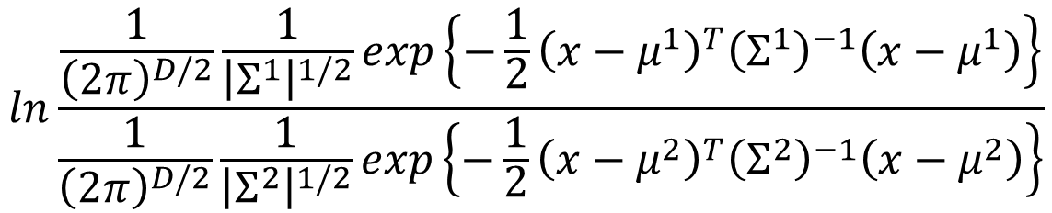
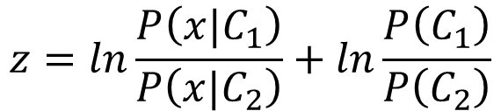

$$z=ln\frac{P\left(x|C_{1}\right)}{P\left(x|C_{2}\right)}+ln\frac{P\left(C_{1}\right)}{P\left(C_{2}\right)}$$
$$=\frac{N_{1}}{N_{2}}$$
$$P\left(x|C_{1}\right)=\frac{1}{{\left(2π\right)}^{D/2}}\frac{1}{{\left|Σ^{1}\right|}^{1/2}}exp\left\{−\frac{1}{2}{\left(x−μ^{1}\right)}^{T}{\left(Σ^{1}\right)}^{−1}\left(x−μ^{1}\right)\right\}$$
$$P\left(x|C_{2}\right)=\frac{1}{{\left(2π\right)}^{D/2}}\frac{1}{{\left|Σ^{2}\right|}^{1/2}}exp\left\{−\frac{1}{2}{\left(x−μ^{2}\right)}^{T}{\left(Σ^{2}\right)}^{−1}\left(x−μ^{2}\right)\right\}$$
$$ln\frac{\frac{1}{{\left(2π\right)}^{D/2}}\frac{1}{{\left|Σ^{1}\right|}^{1/2}}exp\left\{−\frac{1}{2}{\left(x−μ^{1}\right)}^{T}{\left(Σ^{1}\right)}^{−1}\left(x−μ^{1}\right)\right\}}{\frac{1}{{\left(2π\right)}^{D/2}}\frac{1}{{\left|Σ^{2}\right|}^{1/2}}exp\left\{−\frac{1}{2}{\left(x−μ^{2}\right)}^{T}{\left(Σ^{2}\right)}^{−1}\left(x−μ^{2}\right)\right\}}$$
$$=ln\frac{{\left|Σ^{2}\right|}^{1/2}}{{\left|Σ^{1}\right|}^{1/2}}exp\left\{−\frac{1}{2}\left[{\left(x−μ^{1}\right)}^{T}{\left(Σ^{1}\right)}^{−1}\left(x−μ^{1}\right)−{\left(x−μ^{2}\right)}^{T}{\left(Σ^{2}\right)}^{−1}\left(x−μ^{2}\right)\right]\right\}$$
$$=ln\frac{{\left|Σ^{2}\right|}^{1/2}}{{\left|Σ^{1}\right|}^{1/2}}−\frac{1}{2}\left[{\left(x−μ^{1}\right)}^{T}{\left(Σ^{1}\right)}^{−1}\left(x−μ^{1}\right)−{\left(x−μ^{2}\right)}^{T}{\left(Σ^{2}\right)}^{−1}\left(x−μ^{2}\right)\right]$$

Slide 37






$$z=ln\frac{P\left(x|C_{1}\right)}{P\left(x|C_{2}\right)}+ln\frac{P\left(C_{1}\right)}{P\left(C_{2}\right)}$$
$$=\frac{N_{1}}{N_{2}}$$
$$=ln\frac{{\left|Σ^{2}\right|}^{1/2}}{{\left|Σ^{1}\right|}^{1/2}}−\frac{1}{2}\left[{\left(x−μ^{1}\right)}^{T}{\left(Σ^{1}\right)}^{−1}\left(x−μ^{1}\right)−{\left(x−μ^{2}\right)}^{T}{\left(Σ^{2}\right)}^{−1}\left(x−μ^{2}\right)\right]$$
$${\left(x−μ^{1}\right)}^{T}{\left(Σ^{1}\right)}^{−1}\left(x−μ^{1}\right)$$
$=x^{T}{\left(Σ^{1}\right)}^{−1}x−x^{T}{\left(Σ^{1}\right)}^{−1}μ^{1}−{\left(μ^{1}\right)}^{T}{\left(Σ^{1}\right)}^{−1}x$ $+{\left(μ^{1}\right)}^{T}{\left(Σ^{1}\right)}^{−1}μ^{1}$
$$=x^{T}{\left(Σ^{1}\right)}^{−1}x−2{\left(μ^{1}\right)}^{T}{\left(Σ^{1}\right)}^{−1}x+{\left(μ^{1}\right)}^{T}{\left(Σ^{1}\right)}^{−1}μ^{1}$$
$${\left(x−μ^{2}\right)}^{T}{\left(Σ^{2}\right)}^{−1}\left(x−μ^{2}\right)$$
$$=x^{T}{\left(Σ^{2}\right)}^{−1}x−2{\left(μ^{2}\right)}^{T}{\left(Σ^{2}\right)}^{−1}x+{\left(μ^{2}\right)}^{T}{\left(Σ^{2}\right)}^{−1}μ^{2}$$
$$z=ln\frac{{\left|Σ^{2}\right|}^{1/2}}{{\left|Σ^{1}\right|}^{1/2}}$$
$$−\frac{1}{2}x^{T}{\left(Σ^{1}\right)}^{−1}x+{\left(μ^{1}\right)}^{T}{\left(Σ^{1}\right)}^{−1}x−\frac{1}{2}{\left(μ^{1}\right)}^{T}{\left(Σ^{1}\right)}^{−1}μ^{1}$$
$$+\frac{1}{2}x^{T}{\left(Σ^{2}\right)}^{−1}x−{\left(μ^{2}\right)}^{T}{\left(Σ^{2}\right)}^{−1}x+\frac{1}{2}{\left(μ^{2}\right)}^{T}{\left(Σ^{2}\right)}^{−1}μ^{2}$$
$$+ln\frac{N_{1}}{N_{2}}$$

Slide 38
End of Warning

Slide 39










$$P\left(C_{1}|x\right)$$
$$=σ\left(z\right)$$
$$z=ln\frac{{\left|Σ^{2}\right|}^{1/2}}{{\left|Σ^{1}\right|}^{1/2}}$$
$$−\frac{1}{2}x^{T}{\left(Σ^{1}\right)}^{−1}x+{\left(μ^{1}\right)}^{T}{\left(Σ^{1}\right)}^{−1}x−\frac{1}{2}{\left(μ^{1}\right)}^{T}{\left(Σ^{1}\right)}^{−1}μ^{1}$$
$$+\frac{1}{2}x^{T}{\left(Σ^{2}\right)}^{−1}x−{\left(μ^{2}\right)}^{T}{\left(Σ^{2}\right)}^{−1}x+\frac{1}{2}{\left(μ^{2}\right)}^{T}{\left(Σ^{2}\right)}^{−1}μ^{2}$$
$$+ln\frac{N_{1}}{N_{2}}$$
$$Σ_{1}=Σ_{2}=Σ$$
$$z={\left(μ^{1}−μ^{2}\right)}^{T}Σ^{−1}x−\frac{1}{2}{\left(μ^{1}\right)}^{T}Σ^{−1}μ^{1}+\frac{1}{2}{\left(μ^{2}\right)}^{T}Σ^{−1}μ^{2}+ln\frac{N_{1}}{N_{2}}$$
$$w^{T}$$
$$b$$
$$P\left(C_{1}|x\right)=σ\left(w∙x+b\right)$$
How about directly find w and b?
In generative model, we estimate $N_{1},$ $N_{2}$, $μ^{1}$, $μ^{2}$, $Σ$
Then we have w and b

